Slide 1


Developing a generator set scheduling table
Shipboard Power System Fundamentals
Revision of 4 February 2026
Dr. Norbert Doerry
http://doerry.org/norbert/MarineElectricalPowerSystems/index.htm
© 2026 by Norbert Doerry
This work is licensed via: CC BY 4.0 (https://creativecommons.org/)

Slide 2
Essential Questions
What is a generator set scheduling table and how is it used? | Understand
How is a generator set scheduling table developed for operating with all generators paralleled? | Apply
How is a generator set scheduling table developed for operating in split plant? | Apply
How is a generator set scheduling table dependent on an operating condition ? | Understand

Slide 3
Generator Set Scheduling Table
For a given range of electrical load, provides recommendation for …
  Online status of generator sets.
  The method for determining how much power each online generator set provides.
    Share – equally shares with other generator sets marked as share.
    Constant power – provides a constant power (typically either Maximum or Minimum).
    Swing – provides the difference between the total load and the power provided by all other paralleled generator sets.
Usual Objectives …
  Minimize fuel consumption.
  Meet operating constraints for power system reliability (Quality of Service)
Each operational condition may have its own generator set scheduling table.
  Different operating constraints.
In design, the generator set scheduling table ensures consistent generator set line-ups are used in simulation and analysis.
The Generator Set Scheduling Table is usually incorporated into the Electrical Power System Concept of Operation (EPS-CONOPS).
In operation, while the ship operators are not required to follow the generator set scheduling table, they should have a good reason to depart from it.

Slide 4
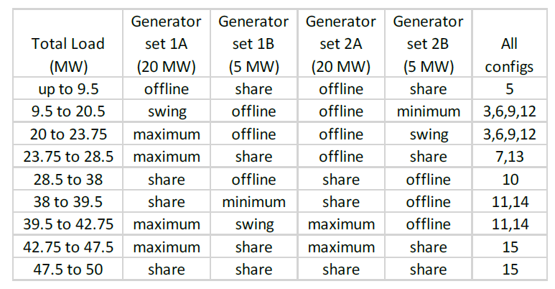
Example

Slide 5
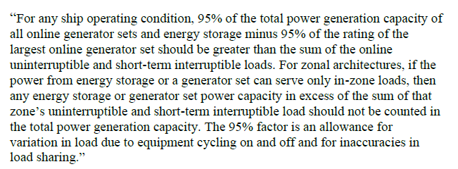
Operating constraints
Most commercial ships and some operational conditions for naval ships
  Electrical power system normally operated as a single power system with all generator sets paralleled.
  If sufficient energy storage not available, the total online generation capacity multiplied by 0.95 should be no less than the electrical load. (To account for load variation and imperfect power sharing)
  For QOS considerations, IEEE 45.1 states …

Slide 6
Operating Constraints (continued)
Some operating conditions (such as battle for naval ships and restricted maneuvering) the electrical power system is operated in “split plant”
  Power system operated as two independent systems.
  Upon loss of power to one system, bus transfer devices switch mission critical loads to the powered system.
    Powered system should have sufficient capacity after load shedding to serve the transferred mission critical loads.
  May be possible to reallocate some loads from one independent system to the other to minimize number of online generator sets.
Energy storage may prove useful
  Provide capacity to satisfy QOS criteria
  Enable generator sets to operate at full rating instead of 0.95 times full rating.
  Enable operating with a single generator set online.
Generator set minimum rating
  Operating a generator set at low power levels possible, but may result in greater maintenance requirements; operating below the minimum rating should be minimized.
  Diesel generator sets should normally be loaded to greater than 30% of rated power.
  Gas turbine generator sets should normally be loaded to greater 50% of rated power.

Slide 7
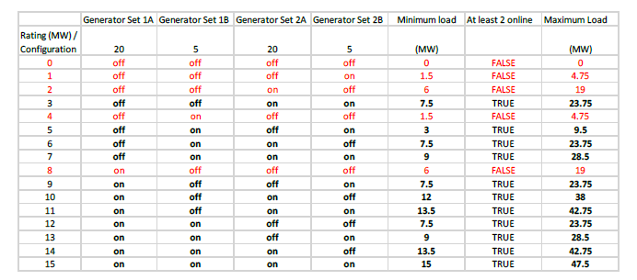
Determining minimum and maximum load for different generator set line-ups.
For n generator sets, there are 2^{n} possible configurations of generator sets being online or offline.
For each configuration, calculate the minimum and maximum load.
  Add up the minimum loads for online generator sets.
  Add up the maximum loads for online generator sets.
Eliminate configurations that don’t meet QOS requirements.
  If no energy storage, eliminate configurations with only one generator set.
Group configurations that have the same minimum and maximum load.
Configurations in red eliminated
Groups:
3, 6, 9, 12
5
7,13
10
11,14
15

Slide 8
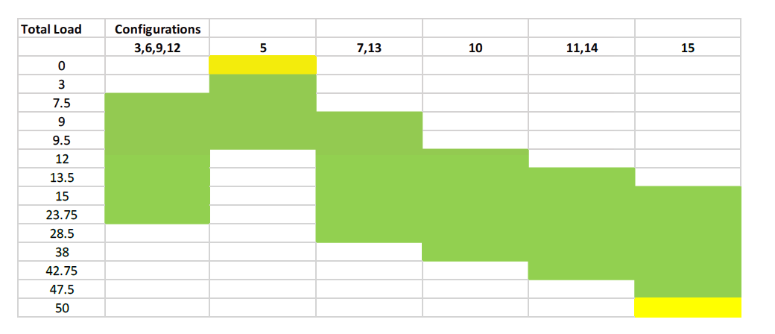
Create range of loads graph
Create a table where each row corresponds to a minimum or a maximum load a group of configurations can support.
  Also include 0 total load and 100% of the rating of all generator sets.
The columns correspond to the group of configurations.
Color the cells green if the total load for the row falls between the minimum and maximum (inclusive) load for the group of configurations.
For the first row, color the cell corresponding to the group of configurations that would be least lightly loaded yellow.
For the last row, color the cell corresponding to the group with all generator sets online yellow.
For remaining analysis, choose one configuration from each group of configurations as representative for the group.
For a given total load, this graph indicates which group of configurations are feasible; still need to know which group of configurations is best.

Slide 9
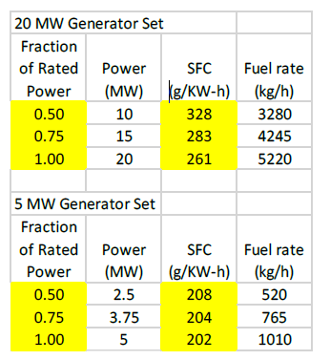
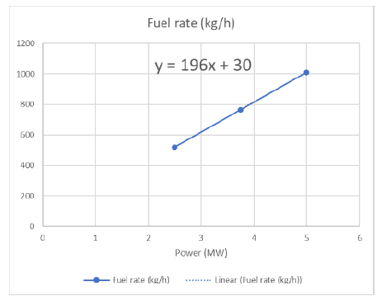
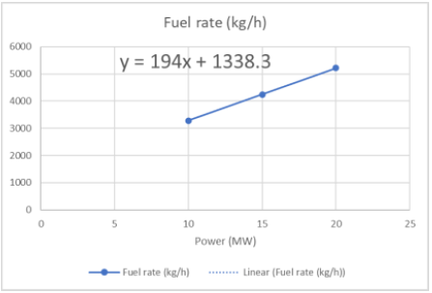
Calculate Fuel Rates
Fuel consumption for generator sets typically provided as specific fuel consumption (sfc) for a few operating point.
Best practice is to convert the sfc values to fuel rates, curve fit the fuel rate points, then use the resulting curve to estimate fuel rates for a given power level.
20 MW Generator set
5 MW Generator set

Slide 10
Optimal operating point for configurations with two different types of generator sets
Assumes fuel rates are linear. More complex analysis is required if nonlinear or more than two types of generator sets.
Set the generator sets with the higher fuel rate linear coefficient to their minimum operating load. Set the generator sets with the lower fuel rate linear coefficient to their maximum operating load. Sum the operating loads and call the sum the transition power.
If the desired load power is not more than the transition power, leave the generator sets with the higher linear coefficient at their minimum operating load and divide the remaining desired load power among the generator sets with the lower linear coefficient.
If the desired load power is more than the transition power, leave the generator sets with the lower linear coefficient at their maximum operating load and divide the remaining given load power equally among the generator sets with the higher linear coefficient.
Calculate the fuel rates for all the generator sets individually, then sum for a total fuel rate for the configuration.

Slide 11
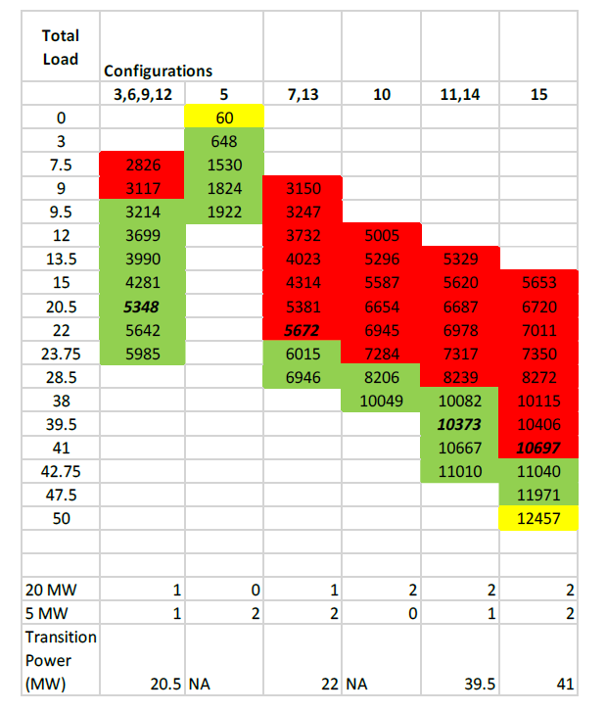
Modify the range of loads graph to include transition powers and add fuel rates
Add rows for each configuration transition power.
For each group of configurations, calculate the fuel rate for each row.
For each row, color the cells with the lowest fuel rate green, all others color red.
If in a column, the last colored cell is green, also color the cell for that row in the column with the second lowest fuel rate.
For a given set of configurations, mark the fuel rate corresponding to the transition power (Bold italic in this case)

Slide 12
Create Scheduling Table
Each column of green cells corresponds to one or two rows of the scheduling table.
  If the green cells include the transition power, then create two rows
  If the green cells do not include the transition power, then create only one row.

Slide 13
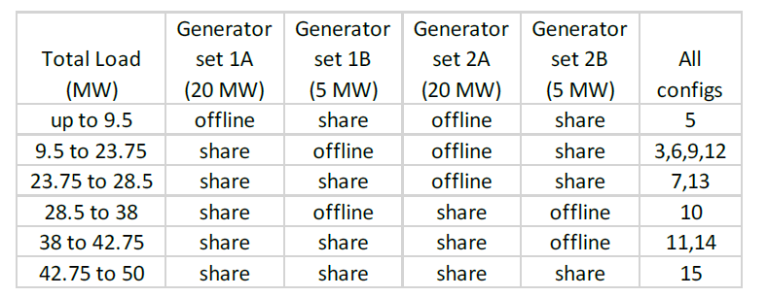
Simplification
In this case, the linear coefficients for the fuel rates of the two types of generator sets are nearly identical.
Sharing power equally (as a fraction of rated power) results in less than 0.1% increase in fuel rate – well within estimation tolerances.
Justifies simplifying the generator set scheduling table.

